Slide 1
Getting Energy to Make ATP
Br Adam Ali

Slide 2
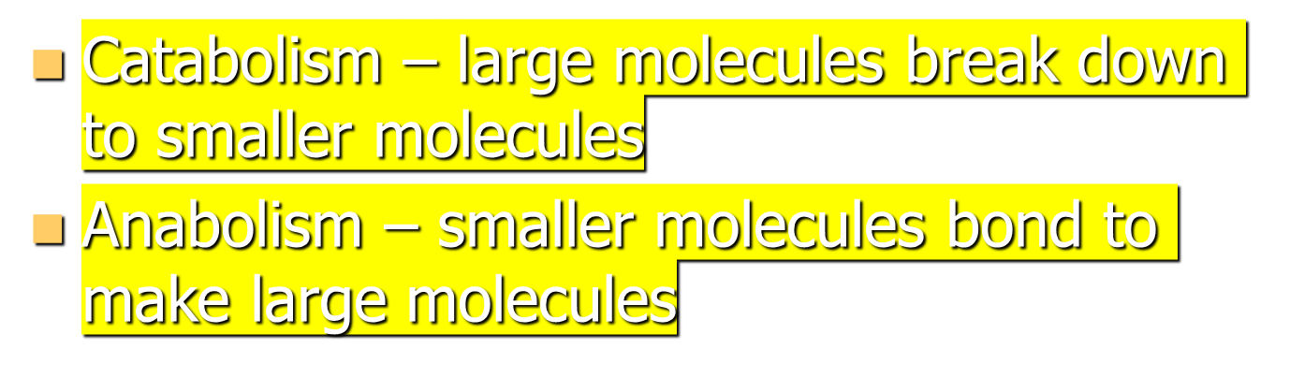
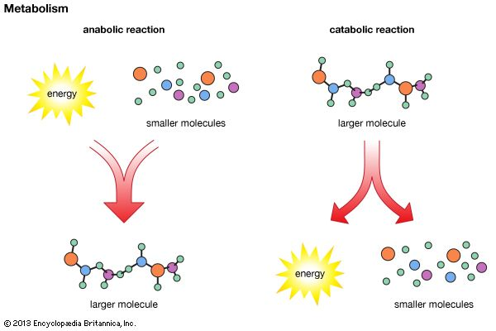
Catabolism and anabolism

Slide 3
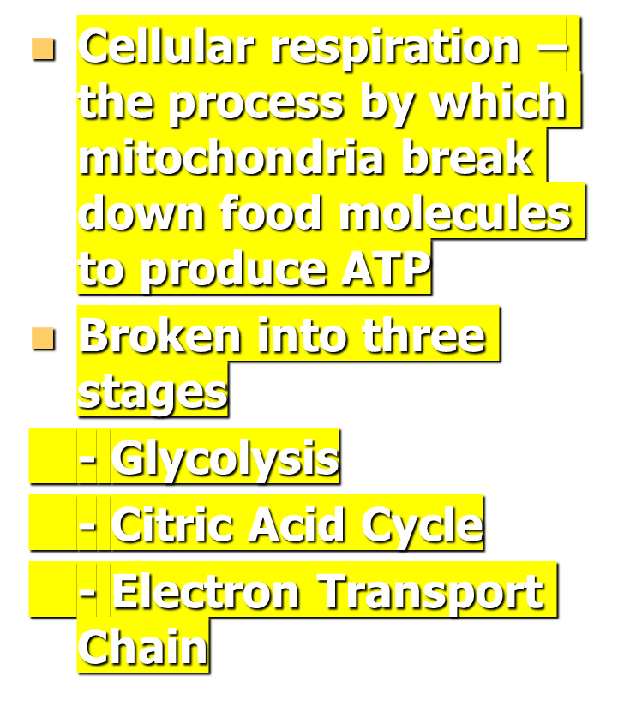
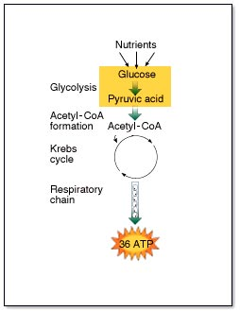
Cellular Respiration

Slide 4
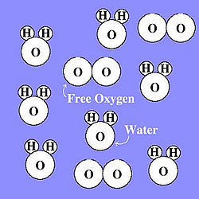
Anaerobic vs. Aerobic
Anaerobic – no oxygen required
Glycolysis is anaerobic
Aerobic – requiring oxygen
The citric acid cycle and electron transport chain require oxygen

Slide 5
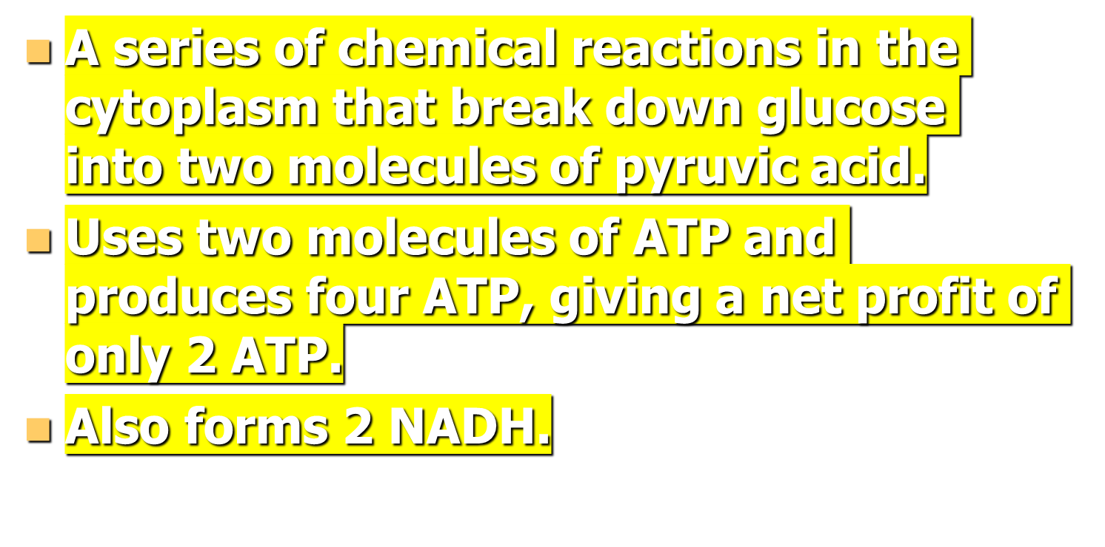
Glycolysis

Slide 6
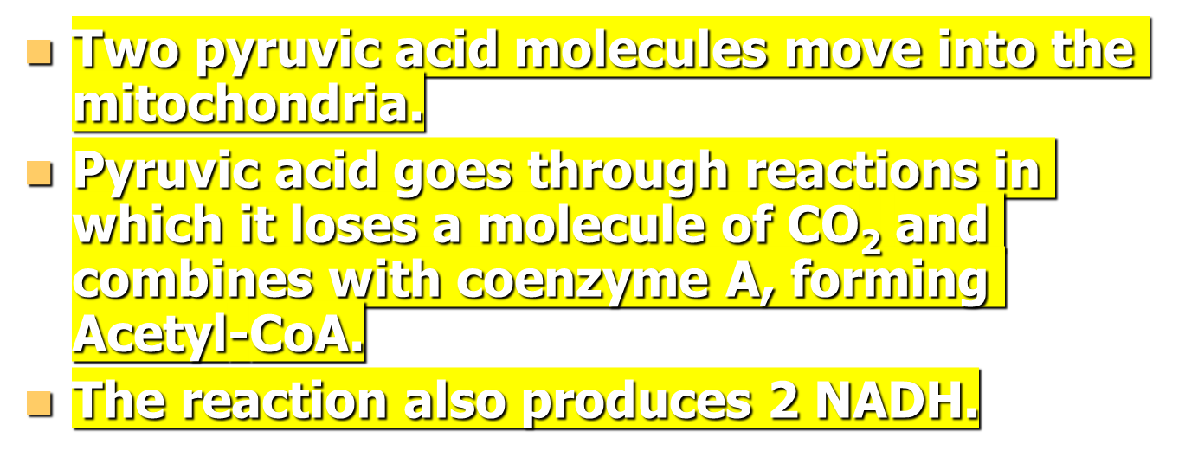
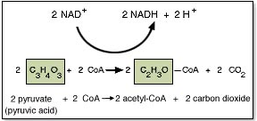
Before the Citric Acid Cycle

Slide 7
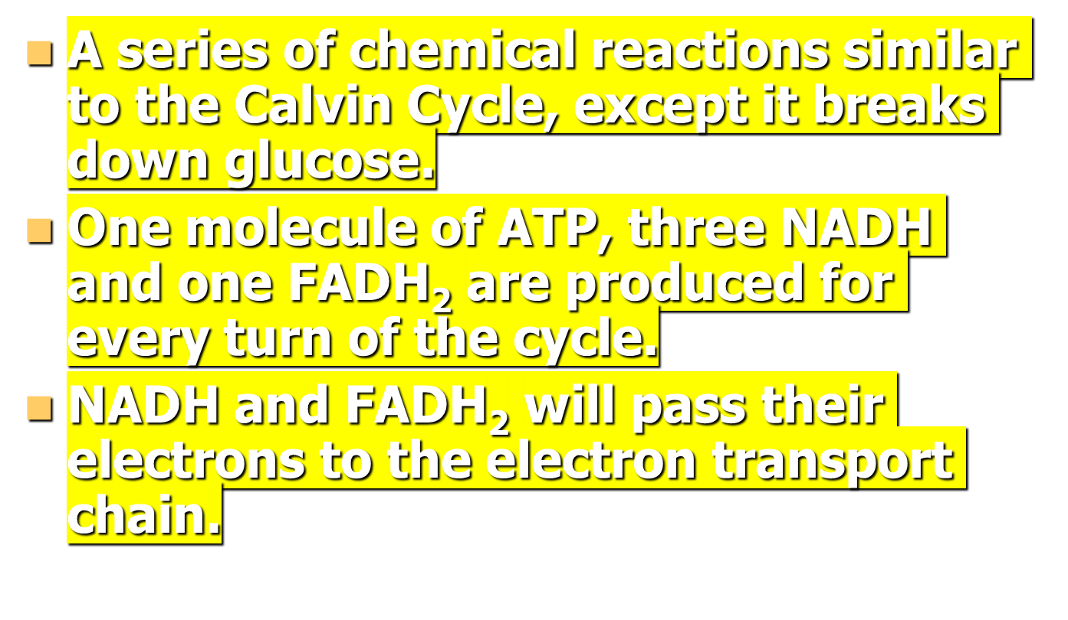
Citric Acid/Krebs Cycle

Slide 8
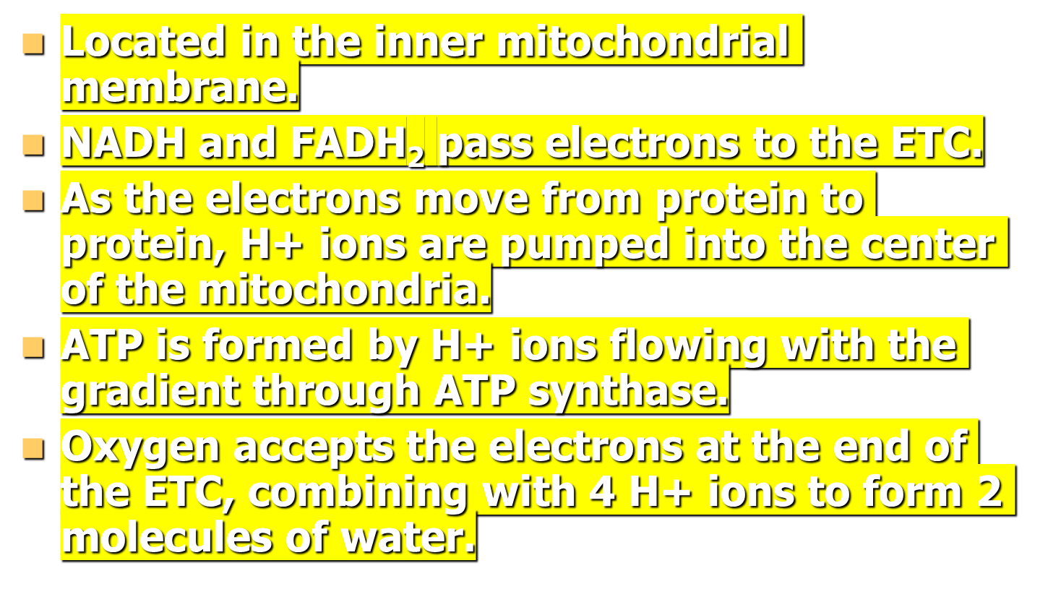
Electron Transport Chain

Slide 9
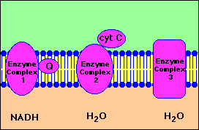
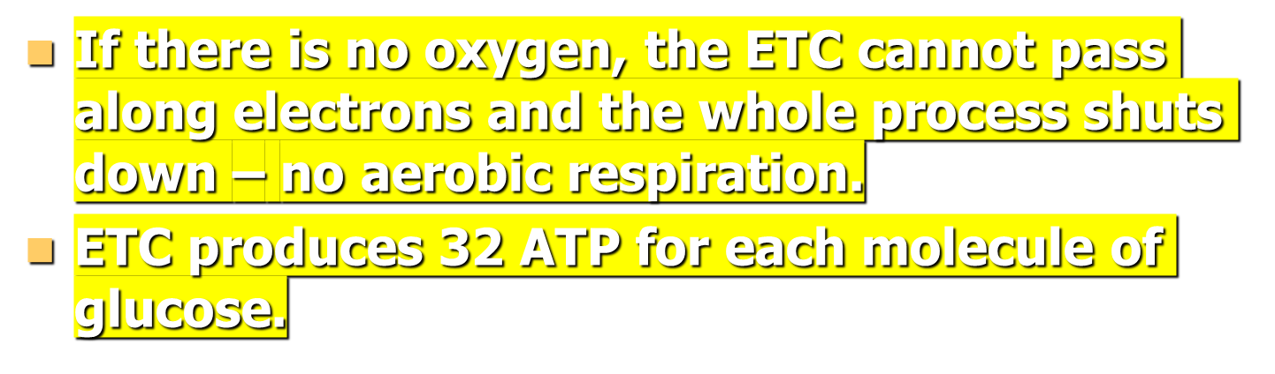
Electron Transport Chain cont.

